Slide 1
Partial Mean
https://nrich.maths.org/6718
Who took it from
UKMT Mathematical Challenges

Slide 2




Partial Mean
The mean mass of items in a group of $64$ items is $64$ kg.
The mean mass of $36$ of them is $36$ kg.
What is the mean mass of the other $28$ ?

Slide 3

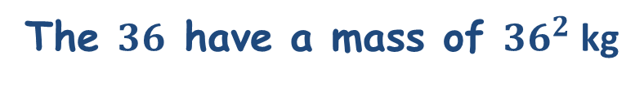
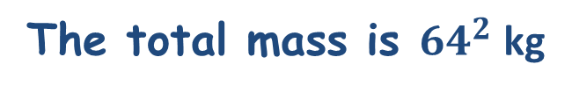
Partial Mean
The mean mass of items in a group of $64$ items is $64$ kg.
The mean mass of $36$ of them is $36$ kg.
What is the mean mass of the other $28$ ?
The total mass is ${64}^{2}$ kg
The $36$ have a mass of ${36}^{2}$ kg
The $28$ have a mass of ${(64}^{2}−{36}^{2})$ kg

Slide 4
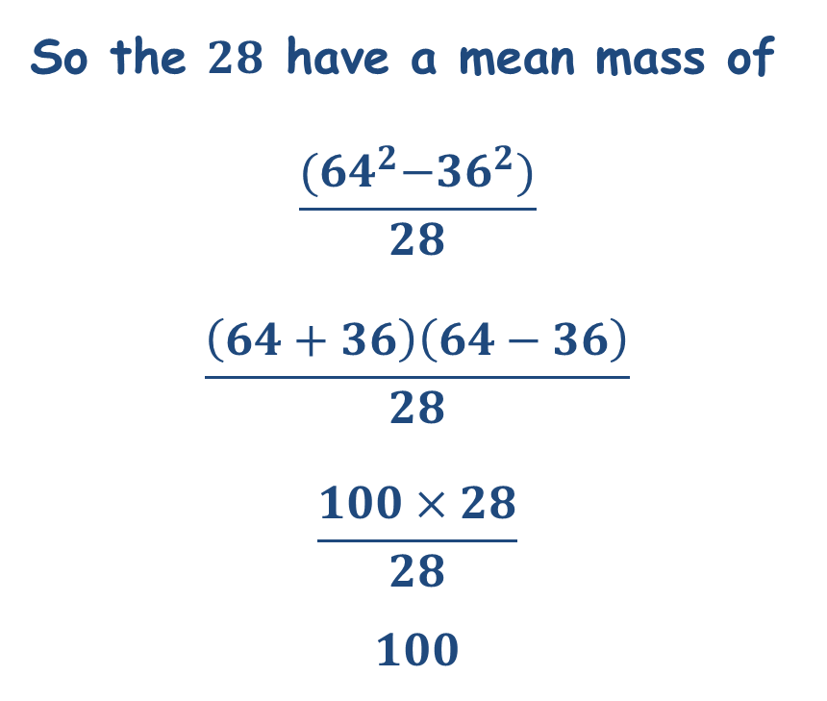

Partial Mean
So the $28$ have a mean mass of
$$\frac{{(64}^{2}−{36}^{2})}{28}$$
$$\frac{\left(64+36\right)\left(64−36\right)}{28}$$
$$\frac{100×28}{28}$$
$$100$$
The $28$ have a mean mass of $100$ kg.

Slide 5
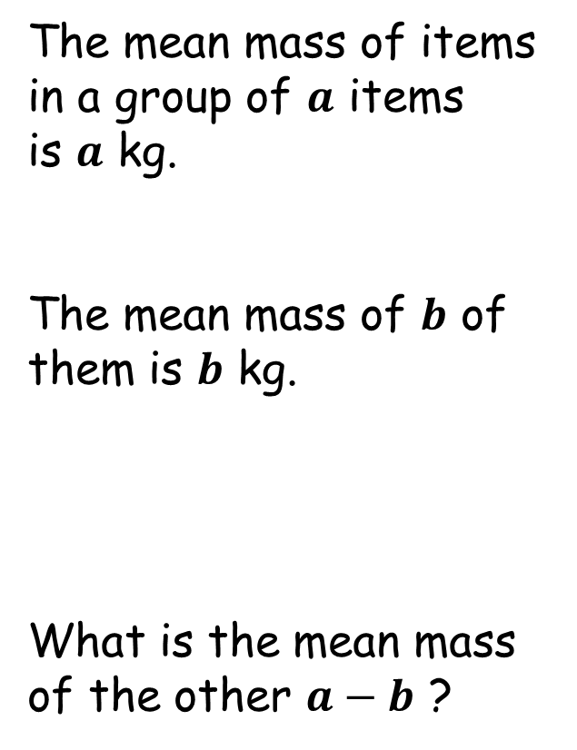
Partial Mean
The mean mass of items in a group of $a$ items is $a$ kg.
The mean mass of $b$ of them is $b$ kg.
What is the mean mass of the other $a−b$ ?

Slide 6


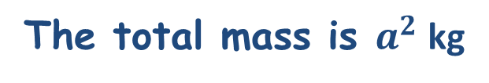
Partial Mean
The mean mass of items in a group of $a$ items is $a$ kg.
The mean mass of $b$ of them is $b$ kg.
What is the mean mass of the other $a−b$ ?
The total mass is $a^{2}$ kg
The $b$ have a mass of $b^{2}$ kg
The $a−b$ have a mass of ${(a}^{2}−b^{2})$ kg

Slide 7
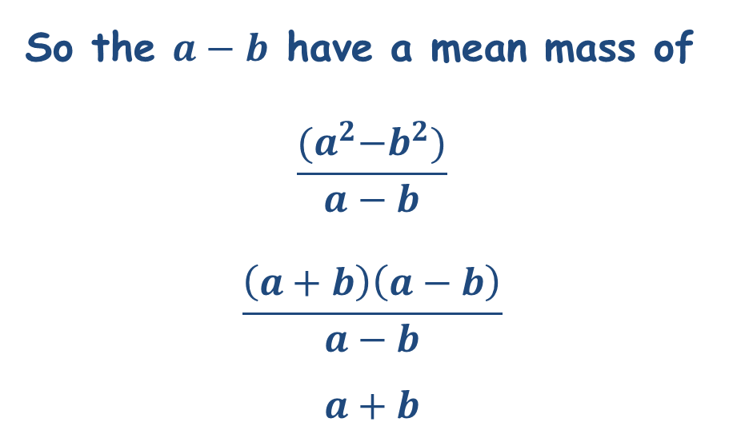

Partial Mean
So the $a−b$ have a mean mass of
$$\frac{{(a}^{2}−b^{2})}{a−b}$$
$$\frac{\left(a+b\right)\left(a−b\right)}{a−b}$$
$$a+b$$
The $a−b$ have a mean mass of $a+b$ kg.

Slide 8


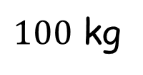
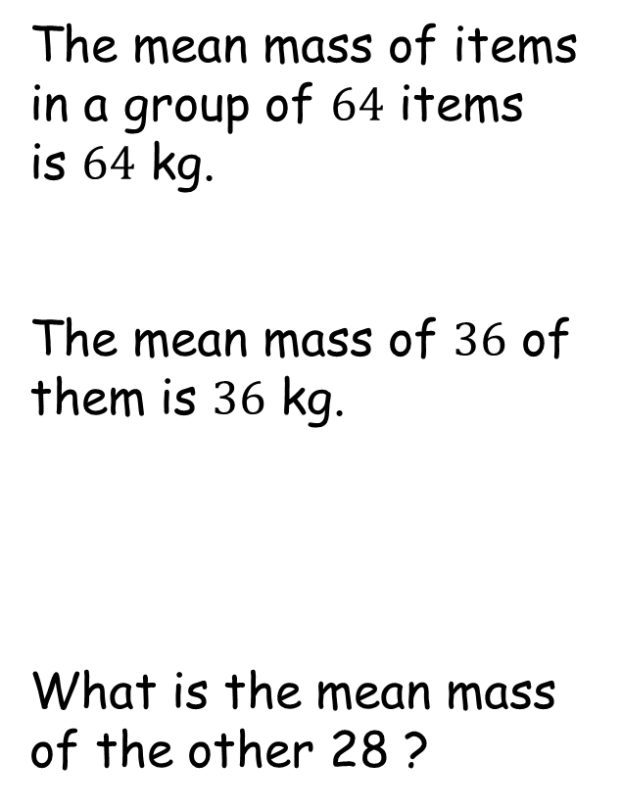
Partial Mean
The mean mass of items in a group of $64$ items is $64$ kg.
The mean mass of $36$ of them is $36$ kg.
What is the mean mass of the other 28 ?
$$+$$
$$=$$
$100$ kg

Slide 10
Note to Teacher
The answers are 99 or 88, but easy for you to know which.

Slide 11
RESOURCES

Slide 12
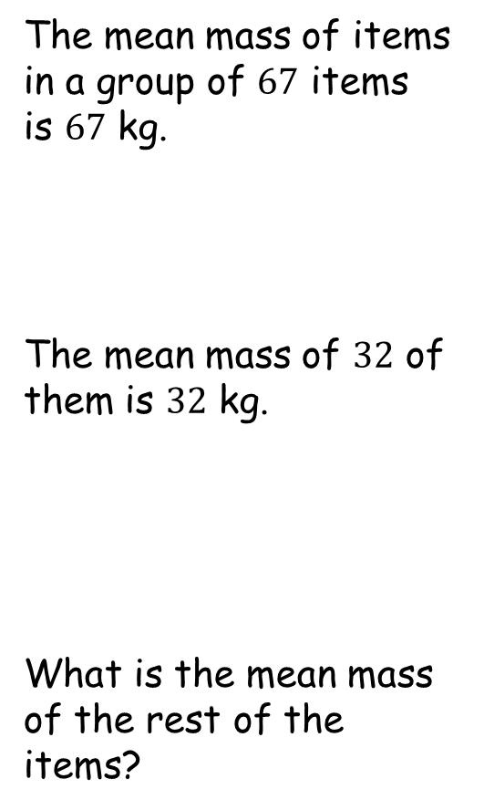
Partial Mean
SIC_67
The mean mass of items in a group of $67$ items is $67$ kg.
The mean mass of $32$ of them is $32$ kg.
What is the mean mass of the rest of the items?

Slide 13
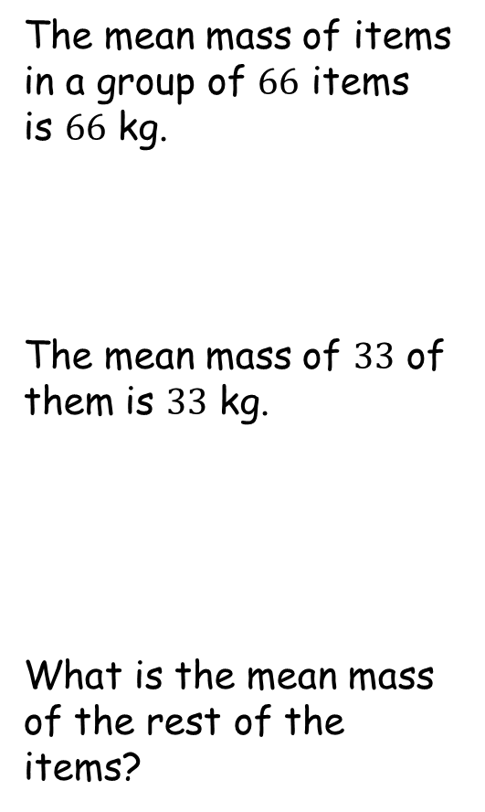
Partial Mean
SIC_67
The mean mass of items in a group of $66$ items is $66$ kg.
The mean mass of $33$ of them is $33$ kg.
What is the mean mass of the rest of the items?

Slide 14
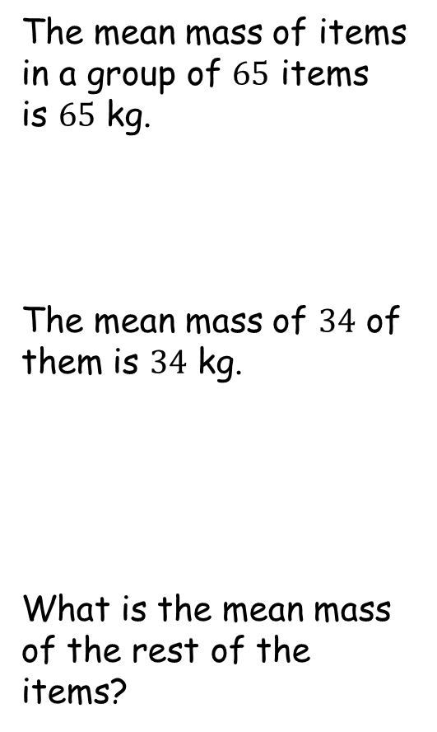
Partial Mean
SIC_67
The mean mass of items in a group of $65$ items is $65$ kg.
The mean mass of $34$ of them is $34$ kg.
What is the mean mass of the rest of the items?

Slide 15
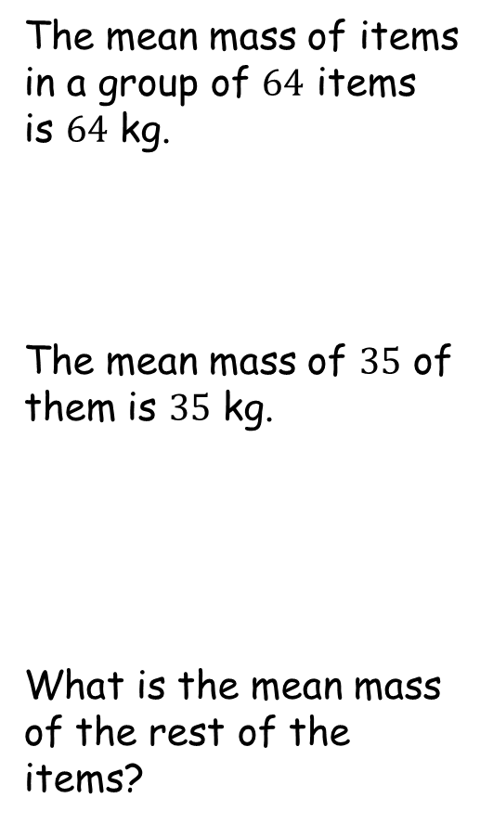
Partial Mean
SIC_67
The mean mass of items in a group of $64$ items is $64$ kg.
The mean mass of $35$ of them is $35$ kg.
What is the mean mass of the rest of the items?

Slide 16
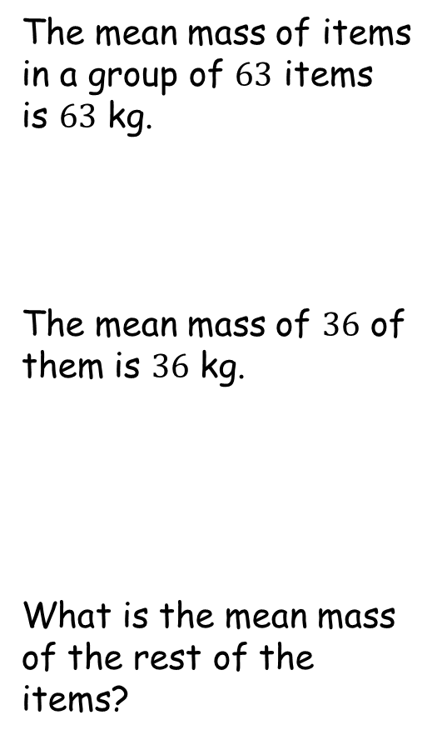
Partial Mean
SIC_67
The mean mass of items in a group of $63$ items is $63$ kg.
The mean mass of $36$ of them is $36$ kg.
What is the mean mass of the rest of the items?

Slide 17
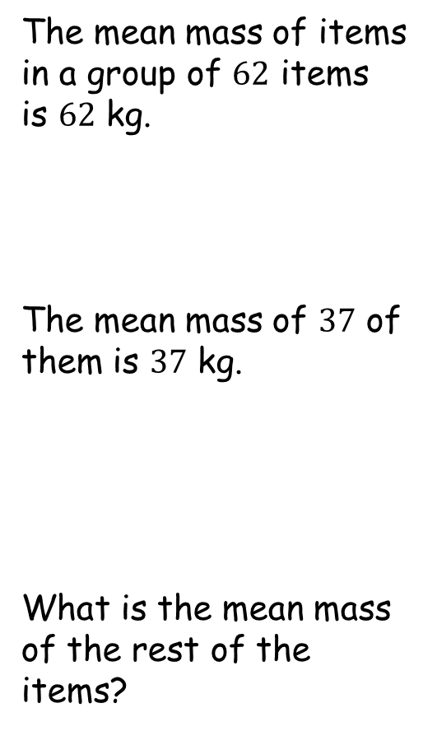
Partial Mean
SIC_67
The mean mass of items in a group of $62$ items is $62$ kg.
The mean mass of $37$ of them is $37$ kg.
What is the mean mass of the rest of the items?

Slide 18
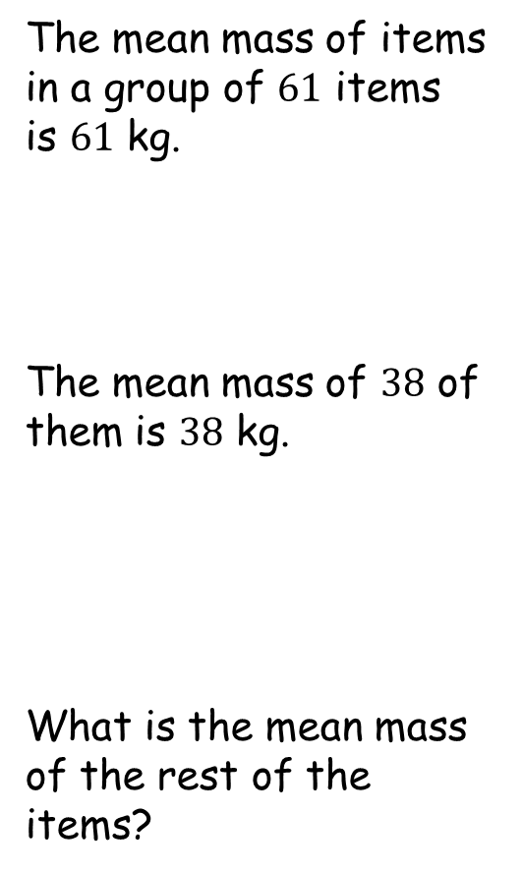
Partial Mean
SIC_67
The mean mass of items in a group of $61$ items is $61$ kg.
The mean mass of $38$ of them is $38$ kg.
What is the mean mass of the rest of the items?

Slide 19
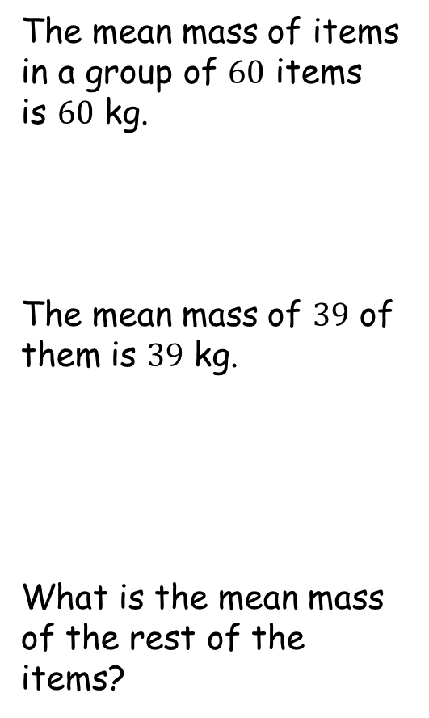
Partial Mean
SIC_67
The mean mass of items in a group of $60$ items is $60$ kg.
The mean mass of $39$ of them is $39$ kg.
What is the mean mass of the rest of the items?

Slide 20
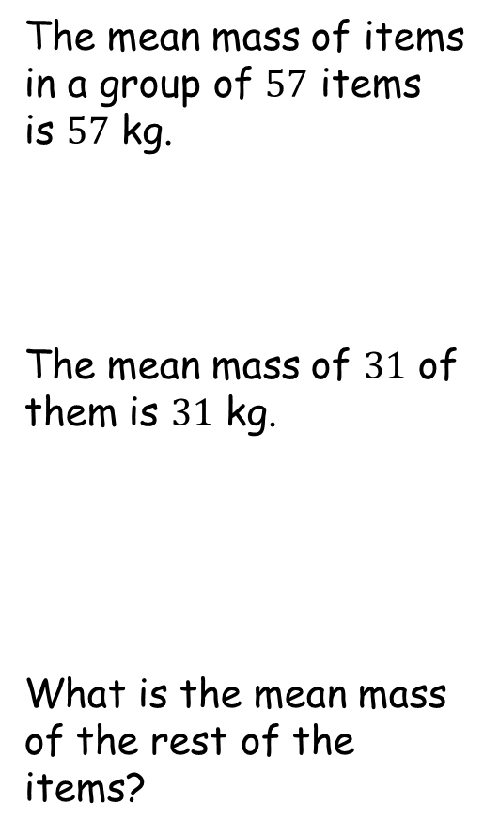
Partial Mean
SIC_67
The mean mass of items in a group of $57$ items is $57$ kg.
The mean mass of $31$ of them is $31$ kg.
What is the mean mass of the rest of the items?

Slide 21
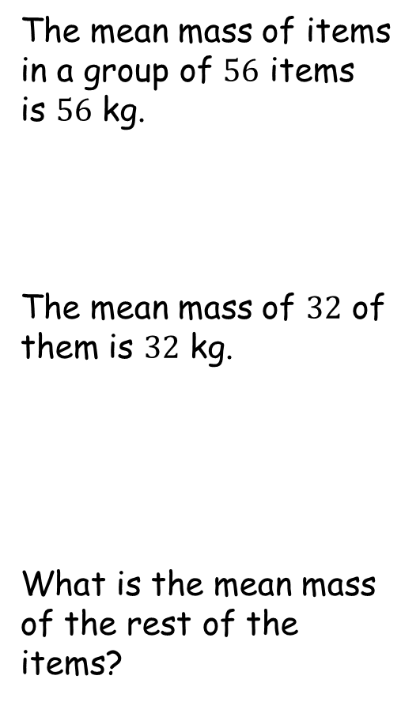
Partial Mean
SIC_67
The mean mass of items in a group of $56$ items is $56$ kg.
The mean mass of $32$ of them is $32$ kg.
What is the mean mass of the rest of the items?

Slide 22
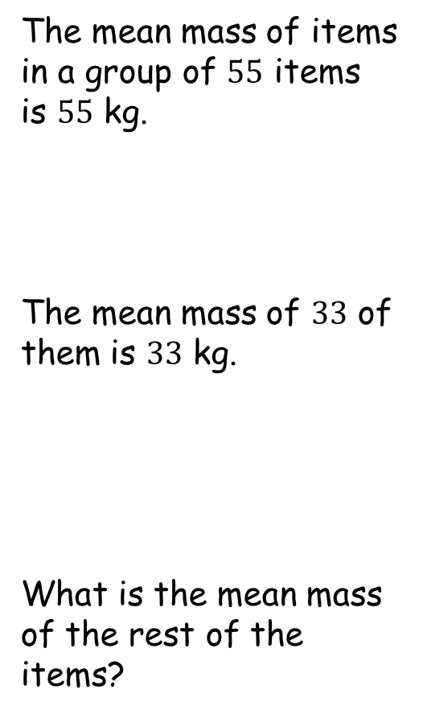
Partial Mean
SIC_67
The mean mass of items in a group of $55$ items is $55$ kg.
The mean mass of $33$ of them is $33$ kg.
What is the mean mass of the rest of the items?

Slide 23
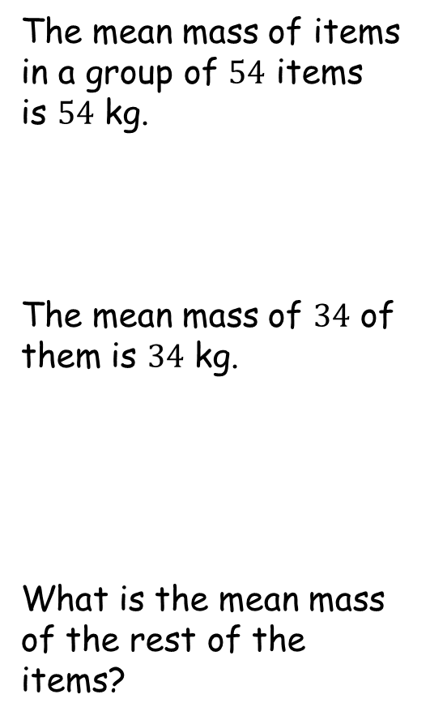
Partial Mean
SIC_67
The mean mass of items in a group of $54$ items is $54$ kg.
The mean mass of $34$ of them is $34$ kg.
What is the mean mass of the rest of the items?

Slide 24
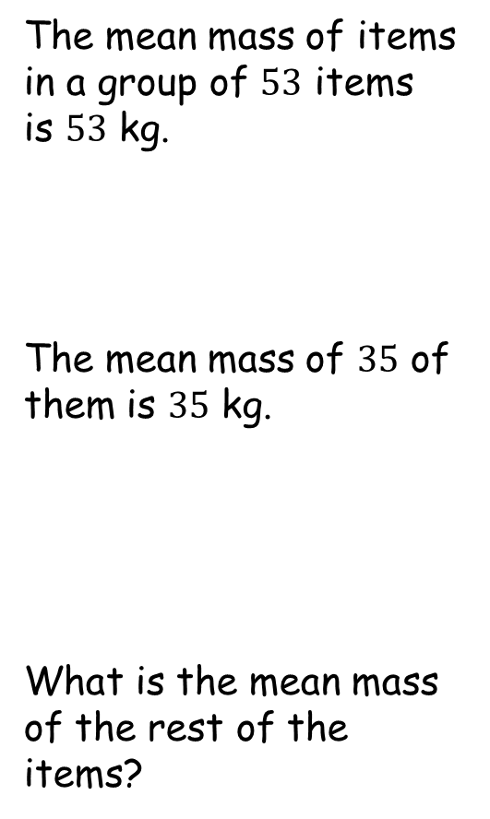
Partial Mean
SIC_67
The mean mass of items in a group of $53$ items is $53$ kg.
The mean mass of $35$ of them is $35$ kg.
What is the mean mass of the rest of the items?

Slide 25
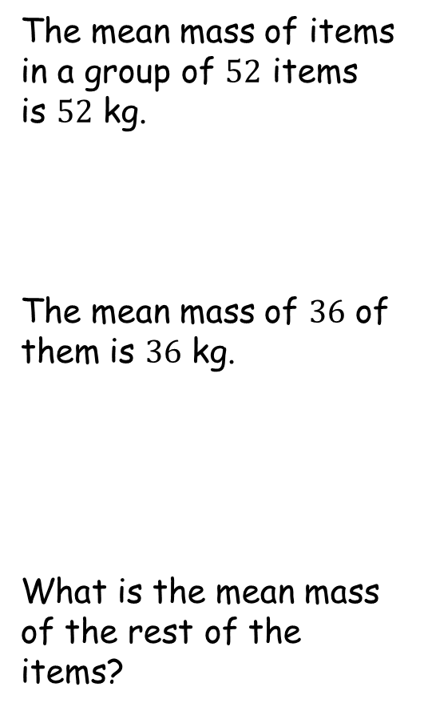
Partial Mean
SIC_67
The mean mass of items in a group of $52$ items is $52$ kg.
The mean mass of $36$ of them is $36$ kg.
What is the mean mass of the rest of the items?

Slide 26
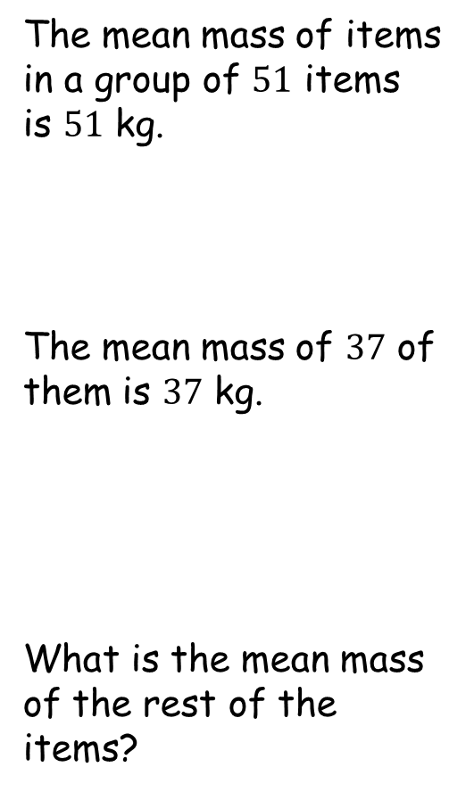
Partial Mean
SIC_67
The mean mass of items in a group of $51$ items is $51$ kg.
The mean mass of $37$ of them is $37$ kg.
What is the mean mass of the rest of the items?

Slide 27
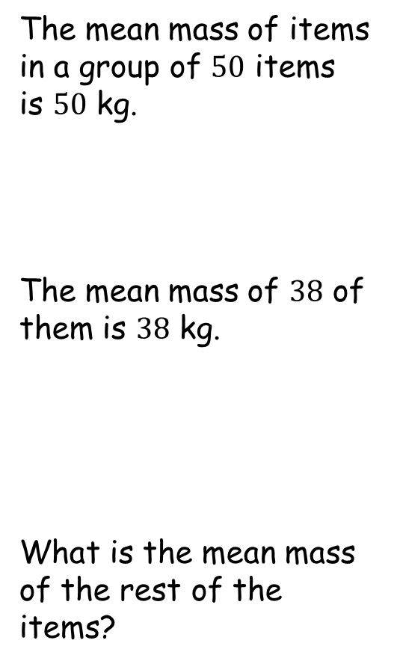
Partial Mean
SIC_67
The mean mass of items in a group of $50$ items is $50$ kg.
The mean mass of $38$ of them is $38$ kg.
What is the mean mass of the rest of the items?

